Slide 1
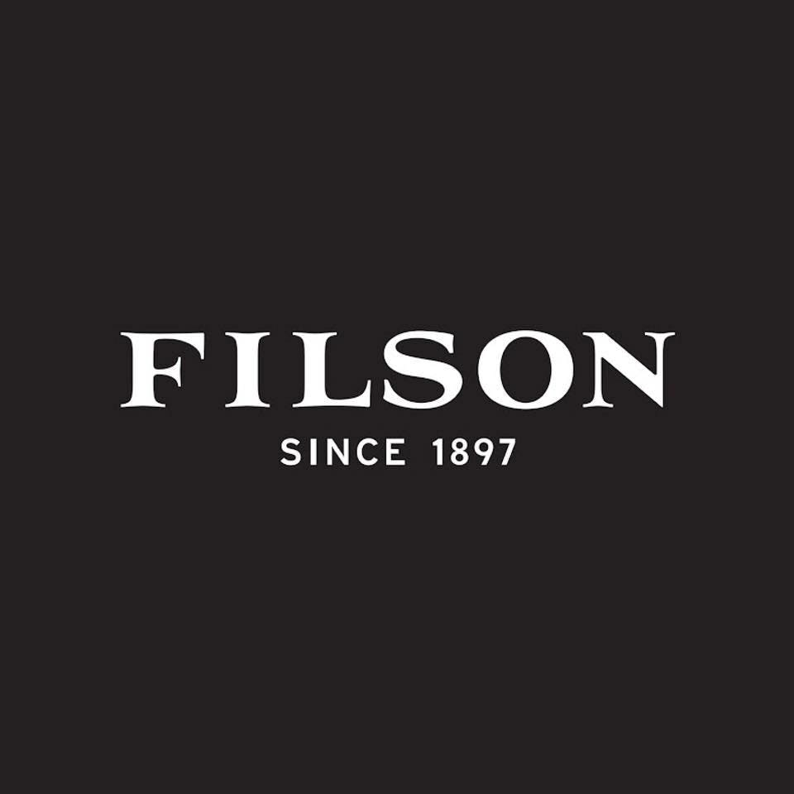
Filson Growth Executive Briefing
By: The Granolas

Slide 2

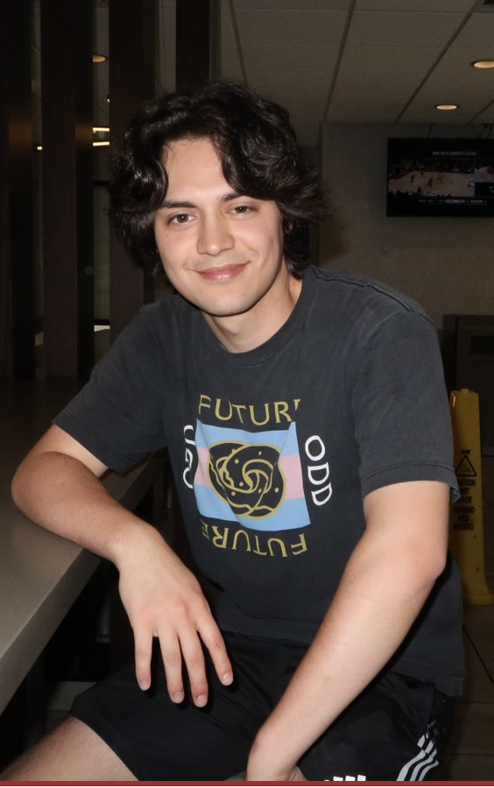




The Granolas Introduction
Natalie
Team Leader
Evan
Cultural/Foreign Market Analyst
Zhu (Juju)
Researcher
Momoka
Data Analyst
Vicky
Data Analyst
Yundi
Researcher

Slide 3
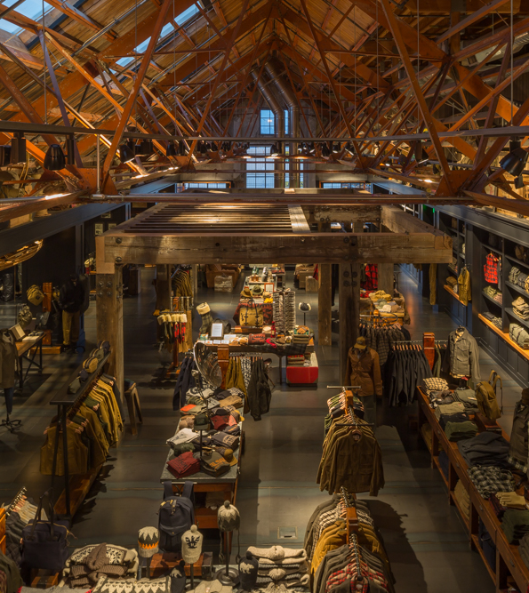
Agenda
Executive summary
Target market recommendation
SWOT analysis
Market indicator matrix
Reason of the target market is a good strategic fit
PESTEL analysis
Market entry strategy
Sustainability plan
Sustainability Profile
Sustainability Assessment
Sustainability Recommendations
Implementation strategy
Segmentation and Target Audience
Product Adaptation
Pricing Strategy
Place: Market coverage, distribution system
Promotion
Roadmap; market development and sustainability

Slide 4
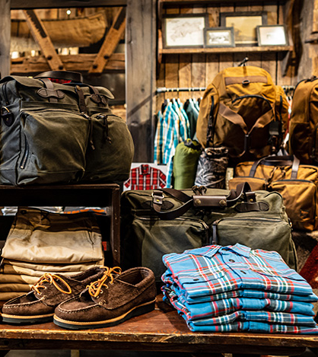
What is Filson?
Filson is a 125-year old privately owned company that focuses on producing high-quality goods for the outdoorsmen and women of the world. They produce everything from clothing to luggage and the sell is in their commitment to giving their customers the best.

Slide 5
Executive Summary
Problem
Solution
Direct foreign presence in Australian market
Offer premium sustainable outdoor products in physical stores
Increase presence in department stores across Australia
Lack recognition in southern hemisphere
Balance the use of quality animal materials with corporate social responsibility
Implementation
Outcome
Phase 1- Prepare for the opening
Conduct market research, find retail partners, and find target audience
Construct a shop, begin advertisements and build excitement, recruit employees
Phase 2 - Launch in 2026 for Rugby World Cup
Phase 3 - Keep up with the trend of sustainability to maintain our profits
Enhance brand awareness, raise reputation
Expand market in southern hemisphere
Keep the flow of all-season products by utilizing seasonal differences between the northern and southern hemispheres
Gain profits

Slide 6
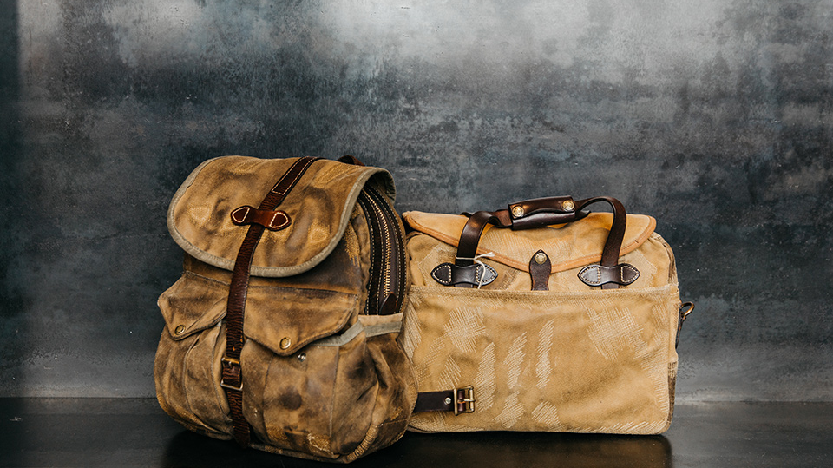
SWOT Analysis:
Strengths
Weaknesses
Outdoor wear built for outdoor enthusiasts, by outdoor enthusiasts
Comfort, protections, durability, and QUALITY in their products
Longstanding brand with a longstanding, passionate consumer base
Lifetime guarantee of their products
High prices
Very niche audience, can’t expand to other demographics
Use of real leather may turn some environmentalists away
Privately owned so funding may be limited
Now manufactures overseas and that is a weakness to some

Slide 7
SWOT Analysis:
Opportunities
Threats
Take the company public
Put stores in other countries to expand consumer market
Break into the vegan leather market to add to the consumer base
Partnering with conservationists
Brands with the same niche and lower prices
Inability to meet demand due to their products being hand-made
Rising cost of materials may hike up prices
Competitors becoming public companies

Slide 8
Market Indicator Selection
Indicator 1 | Level of US Exports to Country | Weight: 1
Indicator 2 | GDP Per Capita of City | Weight: 3
Indicator 3 | Total Market for Outdoor Wear | Weight: 2
Indicator 4 | Online Shopping Engagement | Weight: 2
Indicator 5 | Population of City | Weight: 2
Notes:
Background
From a global perspective, good natural conditions, policy support, economic development, etc. provide growth soil for the sustainable development of outdoor activities. The continued growth of outdoor products is due to the high penetration rate of outdoor sports in various countries. Especially in some countries with relatively good economic development, outdoor activities have a longer history of development.
Active funds and markets
In August 2023, the value of exports of goods in the United States was around $172.51 billion. In 2020, the global outdoor products industry revenue will be nearly $160 billion, a year-on-year increase of 28.33%. It is expected to reach $236.34 billion by 2025, with a CAGR of approximately 6.86% from 2021 to 2025.
Growth of potential consumers
With the innovation of sports forms, the development of e-commerce and other factors, the number of outdoor sporting goods consumers worldwide has exceeded 1 billion in 2022, and the penetration rate is expected to reach nearly 20% in 2025.
Increased focus on sustainable development
According to the ISPO report, trends in the European outdoor market show that 87% of outdoor equipment shoppers are concerned about sustainability, and 53% of buyers are willing to pay a premium for sustainable products. Similarly, it can be believed that the global market is gradually paying attention to environmental protection and sustainable development and is willing to pay for it.

Slide 9

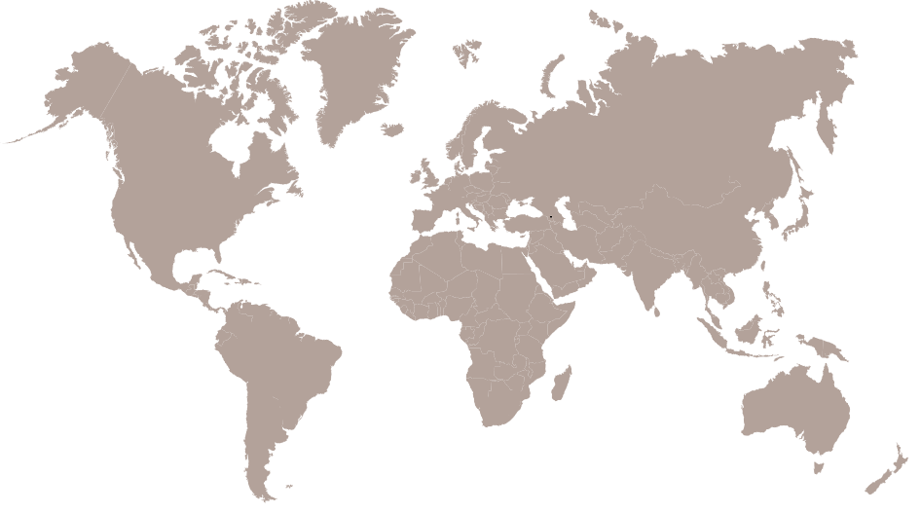
Initial Research Data
GDP Per Capita
Sydney: $54,175
Auckland: $46,974
Beijing: $26,900
Berlin: $45,993
Total Market for Outdoor Wear
UK: $0.55B
AU: $0.35B
FN: $82.45M
CN:$23.15B
DE: $292.7M
Online Shopping Presence
UK: $161B, 38%
AU: $0.35B,10%
FN: $82.45M,20%
DE: $292.7M,22%
Population
Sydney: 5.3 Million
Auckland: 1.6 Million
Beijing: 21.54 Million
Berlin: 3.57 Million
NZ: $5.5B, 18%
Level of US Exports
AU: $30.6B
FN: $2.65B
CN: $151.3B
DE: $72.6B
London: $68,569
Helsinki: $59,289
UK: $76.2B
NZ: $4.17B
NZ: $82.3M
CN:$23.15B,27%
London: 9.0 Million
Helsinki: 0.632 Million

Slide 10
Market Selection Model
City, Country | Indicator 1 | Weight | Points | Indicator 2 | Weight | Points | Indicator 3 | Weight | Points | Indicator 4 | Weight | Points | Indicator 5 | Weight | Points | Total
London, United Kingdom | 5 | 1 | 5 | 10 | 3 | 30 | 0 | 2 | 0 | 3 | 2 | 6 | 4 | 2 | 8 | 49
Sydney, Australia | 2 | 1 | 2 | 8 | 3 | 24 | 0 | 2 | 0 | 10 | 2 | 20 | 2 | 2 | 4 | 50
Auckland, New Zealand | 0 | 1 | 0 | 7 | 3 | 21 | 0 | 2 | 0 | 5 | 2 | 10 | 1 | 2 | 2 | 33
Helsinki, Finland | 0 | 1 | 0 | 9 | 3 | 27 | 0 | 2 | 0 | 5 | 2 | 10 | 0 | 2 | 0 | 37
Beijing, China | 10 | 1 | 10 | 4 | 3 | 12 | 10 | 2 | 20 | 4 | 2 | 8 | 10 | 2 | 20 | 70
Berlin, Germany | 5 | 1 | 5 | 7 | 3 | 21 | 0 | 2 | 0 | 5 | 2 | 10 | 2 | 2 | 4 | 40
Notes:
Level of US Exports
UK: $76.2B
AU: $30.6B
NZ: $4.17B
FN: $2.65B
CN: $151.3B
DE: $72.6B
GDP Per Capita
London: $68,569
Sydney: $54,175
Auckland: $46,974
Helsinki: $59,289
Beijing: $26,900
Berlin: $45,993
Total Market for Outdoor Wear
UK: $0.55B
AU: $0.35B
NZ: $82.3M
FN: $82.45M
CN:$23.15B
DE: $292.7M
Online Shopping Presence
UK: $161B, 38%
AU: $0.35B,10%
NZ: $5.5B, 18%
FN: $82.45M,20%
CN:$23.15B,27%
DE: $292.7M,22%
Population
London: 9.0 Million
Sydney: 5.3 Million
Auckland: 1.6 Million
Helsinki: 0.632 Million
Beijing: 21.54 Million
Berlin: 3.57 Million

Slide 11
Target Market Selection
Beijing, CN
Scored the highest in
market for outdoor wear
population
Important to consider the low GDP per capita
Risk: Trade relations between US and China may not be favorable
US imports to China is not good compared to Chinese imports to the US
Has not demonstrated a strong preference for sustainable products
Sydney, AU
the lowest online shopping engage
Quite high in GDP per capita
→ able to afford the Filson's luxury goods
a large market for outdoor wear
the stats of Beijing tend to simply be outliers
→ Sydney is a more realistic choice
hunting and outdoor wear as well as high-quality, long lasting, and sustainable products
Market Ranking
Beijing, CN 70
Sydney, AU 50
London, UK 49
Berlin, DE 40
Helsinki, FN 37
Auckland, NZ 33
Final Market: Sydney, Australia
Notes:
Considerations such as Beijing's low GDP per capita and the unfavorable trade relations between the US and China raised concerns that there won’t be enough potential costomers.
On the other hand, Sydney displayed several favorable factors. Sydney's high GDP per capita indicated a greater ability to afford Filson’s products. The city also boasted a significant market for outdoor wear and a preference for high-quality, long-lasting, and sustainable products, aligning with the brand's values.
Therefore, despite Beijing's higher score, we decided to choose Sydney as the target market due to the confidence in the purchasing power and preferences of Sydney's consumers, which seemed more realistic and aligned with the brand's objectives.

Slide 12
PESTEL Analysis
Political | Economic | Social | Technological | Legal | Environmental
Good political relationship with the U.S. Has a trade agreement with the U.S. (The Australia-United States Free Trade Agreement "AUSFTA") The United States is the largest and most significant investor in Australia Protests are allowed | Steady market growth rate Less time consuming to start a business High disposable income | Positive population growth and young trends Similar culture to the US 2/3 of Australians lead an active lifestyle Plenty of opportunity for outdoor activity (watersports, hiking, cycling, and camping are all popular) | Technology incentives Level of innovation Automation R&D activity Technological change Technological awareness | Low tariffs: "AUSFTA" Imports are subject to Goods and Services Tax (roughly 10%) Compliance with the Australian Securities and Investments Commission (ASIC) | Potential for extreme weather Steadily increasing average temperatures Environmental Protection act of 1977 8th highest carbon emissions per capita

Slide 13
Market Entry Strategy Assessment
 | Direct Presence | Licensing | Dealers
Pros | Better market understanding Brand control and image Enhanced customer relationships Supply chain and operational efficiency Increased market share Local talent utilization | Reduced risk and investment Leveraging local expertise Rapid market access Income through royalties Brand expansion with limited resources | Access to established networks Lower direct investment and risk Local market expertise Flexibility and scalability Focus on core competencies
Cons | High initial investment Regulatory challenges Cultural and language barriers Risk exposure Operational complexity High competition with local brands | Less control over brand representation Dependency on the partner Limited market insight Risk of IP misuse Revenue limitation Potential for conflict | Reduced control over brand representation Dependence on dealers Potential for channel conflict Margin sacrifice Limited direct customer engagement Risk of market misalignment

Slide 14
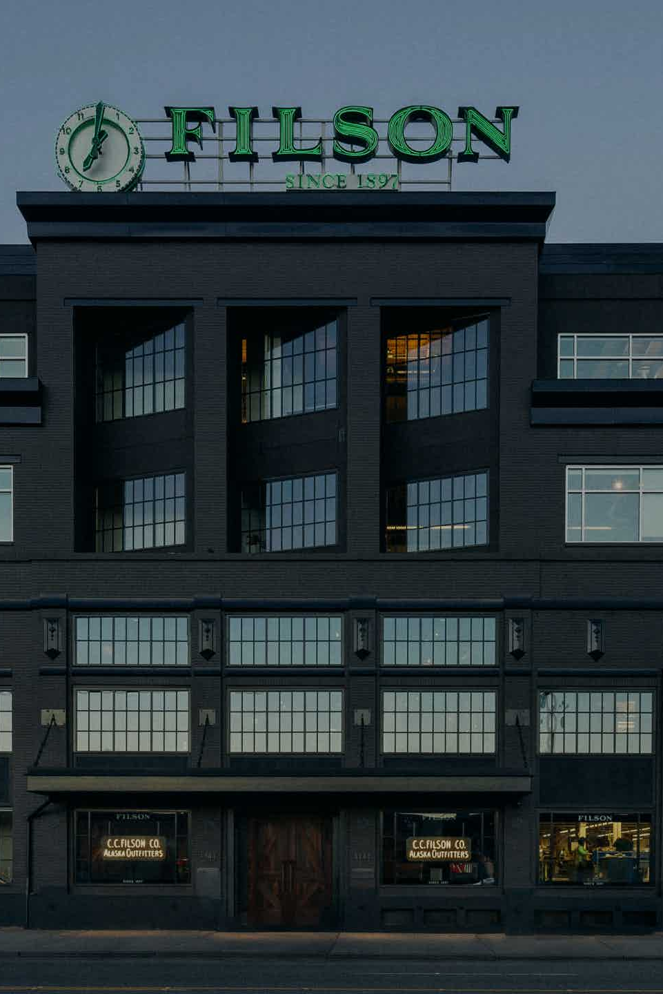
Market Entry Strategy
DIRECT PRESENCE!!
When evaluating market entry strategies, we also consider the following aspects
Past market entry method
Economic benefits
Brand awareness and reputation
Future marketing strategy
Possibility of long-term development
Notes:
When evaluating our market entry strategy with an already globalized company like Filson, it was decided that a new store or, direct presence was the way to go. Filson already had purchasing channels in many countries with physical stores that can also assist e-commerce business. Business in Europe being centered in Italy, orders can be fulfilled in all parts of Europe, within 10 days, but Australia is an underexplored market. Filson's recognition in the southern hemisphere is lacking, and separate transoceanic transportation costs resources. Filson's past market entry was through directly setting up stores. It is more important for the brand to be independently recognized by the public and controlled by the company when setting the entry strategy.

Slide 15
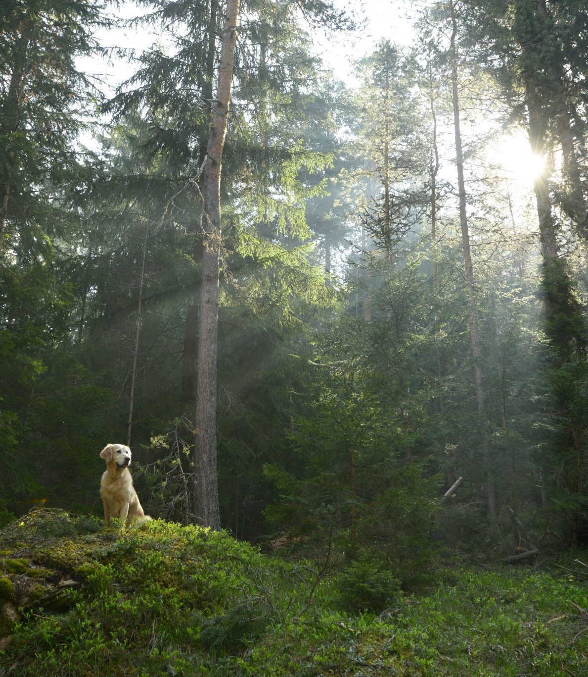



Sustainability Profile
Filson is involved in several conservation projects focused on the protecting wildlife.
For example, Filson heavily supports sustainable logging and has done work to promote sustainable logging in the United States. In fact, Filson dedicates over 60 stories on the journal section of its website on conservation.
Filson supports these conservation organizations:
Filson do their effort in long-lasting manufacturing
they do repairs on their products, and even create some of their products with dead-stock or salvaged materials.
Filson focus on minimizing waste throughout their company from the manufacturing process to within their workspaces.
"Ideals without actions are meaningless. "
Notes:
Filson is committed to protecting wildlife through various conservation projects, with a spotlight on sustainable resource management in the US.
Folson also support key conservation organizations like the National Forest Foundation, Ducks Unlimited, the Conservation Alliance, and more.
Collaborating with these groups to enhance Filson’s collective impact on preserving and safeguarding nature.
Filson's commitment is also evident in long-lasting manufacturing practices. We prioritize durability and sustainability by repairing products and incorporating recycled materials into some of filson’s product lines.
Our commitment to minimizing waste is seen from manufacturing to workspaces.
Filson actively focuses on waste reduction, embodying the belief that "Ideals without actions are meaningless."

Slide 16
Sustainability Assessment
Focus Areas | Findings | Conclusions
People Change | Increased environmental awareness Outdoor activities gaining popularity | Sustainability becomes more important to customers' purchase decision-making Increasing demand for sustainable outdoor clothing
Process Change | Technology and innovation change production processes Sustainability gaining importance in production and advertising | New production technology → sustainable production of clothes Cost and time of replacing current production methods may be high Eco-friendly marketing strategies could be beneficial
Infrastructure Change | New production technology increases production efficiency Allow for experimentation with more materials | Production of more durable outdoor products, applicable to more scenarios, and unique and fashionable Difficult to produce products locally for a single store Production technology may not be matured for cheaper production
Other | Investors in Australia that are concerned with sustainability | Provision of new financial resources for Filson → help with future expansion in the Australian market

Slide 17
Sustainability Assessment
Focus Areas | Findings | Conclusions
Industry-Level Challenges | Consumer trends shifting to online shopping High costs of transpacific shipping | Low e-commerce trends despite increasing popularity A rise in prices in production
Company Specific Challenges | Competition with local outdoor wear brands Being a private company | lean on the "long-lasting, sustainable" marketing strategy Need to improve transparency about goals and figures
Market Forces | Exporting from the US to Australia Inflation and currency exchange Filson products being a luxury good | Higher unit price due to exchange rate AUSFTA policy + durability of Filson's single products → cost-effectiveness
Non-traditional Forces | Environmental push-back against leather goods Appeal of "American-made" in a foreign country | Need to explore alternatives to leather to satisfy eco-friendly demands while maintaining high quality Australia's friendly attitude towards the US → "American-made" being attractive
Business Transformation Phase | Establish leadership in the new country Establish a unified global customer service standards in stores Need for location with high foot traffic | Hiring of expertized locals to help navigate the Australian market and local audience's needs Opening in Central Sydney with high foot traffic

Slide 18
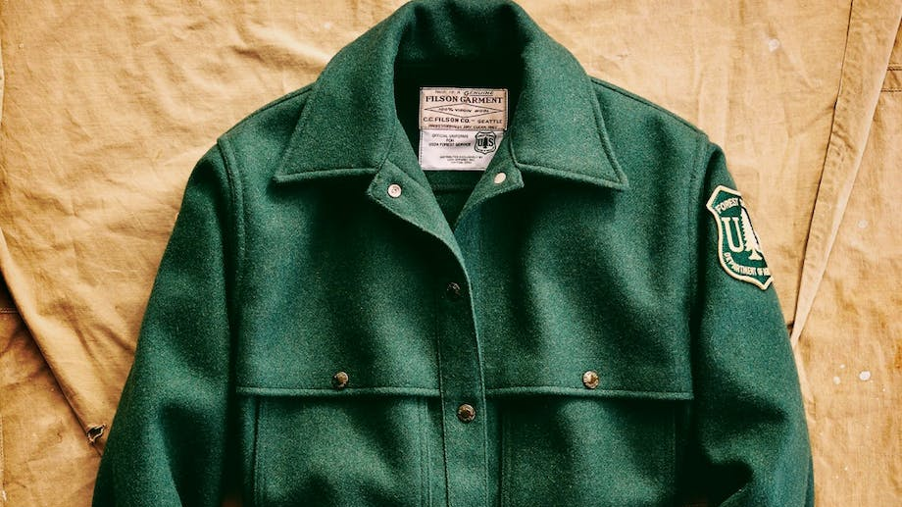
Sustainability Recommendations
Continue business recycling and extended product lifetime business model
Use of paper bags and sustainable packaging and materials within our store
Sustainable packaging throughout shipping process
Maersk eco-shipping for exporting
Notes:
There are many techniques that could be used to continue sustainable responsibility and this includes practicing recycling in our products and employing Product Life Extension techniques. Sustainable packaging within our stores and throughout the distribution process. In the distribution process we will use Maersk eco-shipping which is known to export with lower carbon emissions, and though it would be an added cost, it aligns with the company's values.

Slide 19
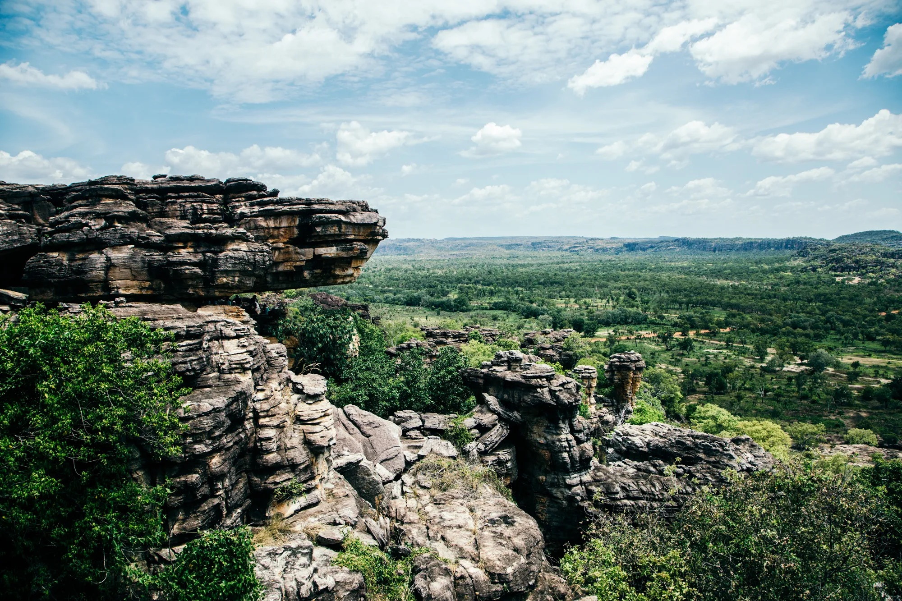

Segmentation and Target Audience
Middle to upper income people (weekly earning $1400 - $2200) that are:
Outdoor enthusiasts
Heritage and quality seekers
Professionals in the outdoor scene
They occupy roughly 10% of the Australian population
Notes:
The best target audience in Australia should be similar to the target audience in the US.
In this regard they will ideally be relatively younger middle to upper income people (weekly earning $1400 - $2200) that are either Outdoor enthusiasts, Heritage and quality seekers or even professionals in the outdoor scene​. Considering these specifications, our target audience will occupy roughly 10% of the Australian population which is about []

Slide 20

Partnering
Myer Department Stores
Main mode of distribution throughout the country outside of our Central Business District store
Import/Export Partners (port in Sydney)
Organize distribution and transportation of products to retail destination
Legal Advisor
Define local sustainability, import/export laws and regulations
Cultural Advisor
Identify niche differences in market culture
Notes:
Marketing Agency Partners will be crucial considering the main goal of this greenfield operation into Australia is to use the direct presence of a brick and mortar store to establish brand recognition. We can offer this agency a cut of the profits we make in Australia while they aid us in establishing a marketing strategy for the first year or so. This partnership may not need to extend beyond this first year or so once we have developed experience in the Australian market.
Import/export partners include shipping companies that can distribute Filson products throughout the country to various retails locations from the port of Sydney. This will need to be very permanent and it is important we choose a reliable company.
A legal advisor is crucial in the beginning to set up the necessary relationships with the correct government agencies to allow for Filson to enter the Australian market. This may be a more temporary partnership.

Slide 21
Marketing Mix
Place and Coverage
Product
Product adaptation strategy: customization and modification
Create offline store in central Sydney near ports
-Sell products in Myer department store nationwide
-Targets majority of (sub)urban Australians
Given Sydney's temperature: use less heavy and more breathable fabrics
Given Australians' love for water sports: consider making wet suits
15% of adults over age 15 participate in water sports
Notes:
Price: We would aim to maintain similar pricing to the US due to Australia’s good economic standing.
Promotion: We can offer discounts since the store is brand new as well as during Australian holidays like Boxing day, having localized sales will grow an Australian market.

Slide 22
Marketing Mix
Price
Business model surrounds durability and high-quality products with a focus on craftsmanship
Meaning not much room for lower prices
Promotion
Utilize product showcases
Have pop-up shops within major department stores
Offer special promotions
Collaboration with Myers
Notes:
Price: We would aim to maintain similar pricing to the US due to Australia’s good economic standing.
Promotion: We can offer discounts since the store is brand new as well as during Australian holidays like Boxing day, having localized sales will grow an Australian market.

Slide 23

Main issues & risks with solutions
Fluctuating currency exchange rates. (Leads to revenue volatility and unstable Cashflows)
Long-term contracts with bank (lock currency exchange rate) + Agile pricing strategy
Different laws and regulations
Different customers behavior due to different cultural and social behavior
Outsource local consulting + Hiring local marketing, law and finance consultants.
Competition in apparel industry (Low barriers for entry + Local brands already have a large market share)
Have its own differentiation characteristics (features) to stand out in the market competition.
Sales performance was not as expected (Pricing strategy & Investment Termination related)
Benchmarking other global outdoor apparel companies and use Continuous improvement model.
Focus on performance of each milestones and expansion project periods.
Damage in warehouse & cargo + Contractor defaults
Employing insurance for potential product loss. Sent on-site employees and apply paneities
Notes:
In terms of economic risks, the fluctuating currency exchange rate could affect Filson’s assets and cash flows. This however, would be the case in almost any foreign market. In order to reduce these risks, Filson will sign long-term contracts with banks to lock in the currency exchange rate in a period of time. Filson should also apply a more agile pricing strategy when they first enter the market.
Laws and regulations also differ in Australia including custom clearance, Intellectual property protection, labor, and advertising. Different customer behaviors and preferences may be seen in this market. In the earlier entry periods, Filson should cooperate with local consulting companies or outsource function teams related to law, finance and marketing issues. After the business is stabilized in the Australia market, Filson can hire more team members in those departments.
Competition is also a consideration, it could be tense due to other local brands in the market. Filson needs to have its own differentiation characteristics to stand out against market competition. For example the store events to have closer ties with local communities. They can promote their unique corporate philosophy.
In terms of sales, performance may not be as expected when they first enter the Australian market. Filson may experience sales depression like low traffic in their retail stores, which brings additional warehousing costs associated with inventory overload. For pricing strategy, Filson could benchmark their pricing with other global apparel companies, especially outdoor clothing like North Face and Columbia. Before entering to next periods, Filson should also use analysis workflows like continuous improvement to evaluate the risks and performance during each gap. Acknowledging when it is time for them to pull their investment when it is not succeeding is also important.
Finally, in the exporting and distribution process, there could be goods damaged and product loss. Filson should employ insurance to cover those losses.

Slide 24
Road to Implementation and Success
Conduct market research, find retail partners, and find target audience
1
Construct a shop, begin advertisements and build excitement, recruit employees
2
Launch in 2026 for Rugby World Cup
3
Give ourselves two years to break even, and begin the return on our investment
4
Strengthen relationships with partners, analyze growth and partnerships
5
Employ a culture of constantly striving for better to build our profit
6
6 months
2024-2026
2026
2026-2028
For a long run
For a long run
Notes:
The stage we’re in right now is the analysis stage where we are seeking out partners, analyzing the market we’re entering, and establishing a target audience. Then we’ll move into building the store and establishing ourselves in Australia, running advertisements, and hiring employees. Our plan is then to launch in 2026 when the Rugby World Cup takes place, this is a time of heavy foot traffic and tourism in the city. We will then give ourselves 2 years to break even. Then comes the improvement analysis stage where we evaluate our partnerships and business practices in order to improve out business model. Finally we will employ a culture of continuous improvement to continue to build our profit and thrive in this new market.

Slide 25
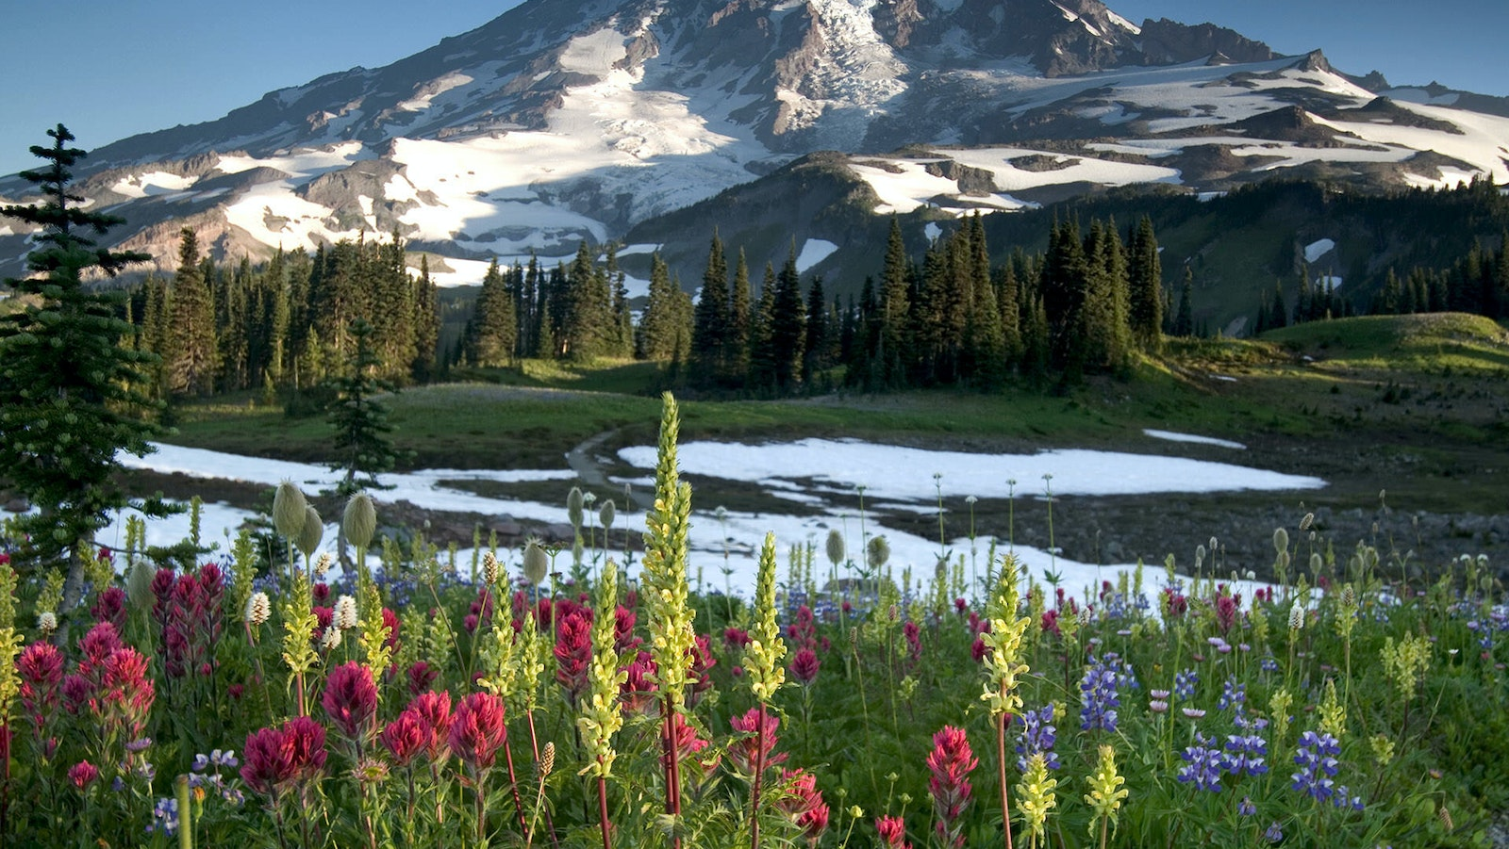
Thank You

Slide 26
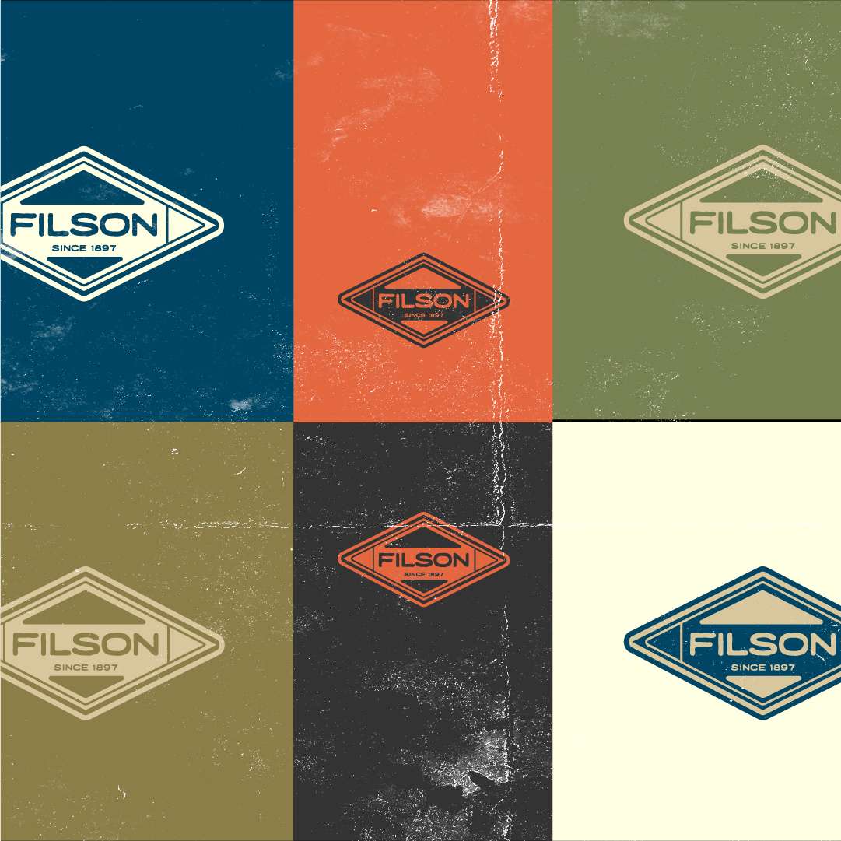
Q&A

